Slide 1
IKAR, a.s.
Bratislava, Slovak Republic

Slide 2
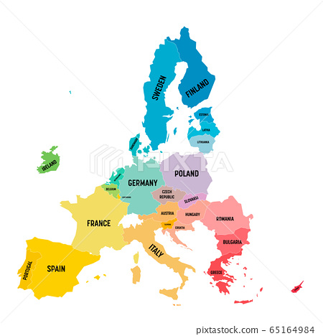
here we are

Slide 3
content
basic info
market situation
stock curation
stock presentation
staff training
customer service
covid impact

Slide 4
basic info
Country specifics:
small country (5.5 M inhabitants)
competition of Czech books
consignment model
fixed prices in brick stores
total market volume roughly 100M EUR

Slide 5
market situation
two dominant bookstores chains
very limited number of specialized stores
up to 100 independent bookstores

Slide 6
stock at bookshops
established bookstores use consignment model
no financial leverage on bookstores’ side
e-shops still buy books directly

Slide 7
stock curation
largest chain Panta Rhei (60 stores)
oriented on mass market
full range of genres
initial orders on relevant new releases done centrally
subsequent orders managed by respective store manager based on sales

Slide 8
stock curation
initial orders reflect potential marketing campaigns – agreed between publisher and bookseller centrally
based on store size and position
automated deliveries
cooperation with suppliers
titles related to specific region

Slide 9
stock presentation
several positions where the titles are presented
some of them are subject to purchase by the publisher
displays dedicated to new releases, bestsellers, short-term thematic panels
presentation by genres – missing common approach within the whole market

Slide 10
staff training
Increasing importance of trained and well oriented staff
information sharing from publishers
newsletters
publishing program
regular meetings with store managers
reading copies

Slide 11
customer service
affiliate program (club cards, discounts)
pick-up of online orders
used books re-buy
special promo offers with the support of the publishers
non-books goods on sale (craft, arts, socks...)
coffeeshops incorporated within bookstore

Slide 12
loyal customers
in-store event with authors
focus on local authors within the region
launch of new titles
public readings – cooperation with libraries
special events for schools

Slide 13
covid impact
despite total books market growth, brick stores hit hardest
extreme long lockdowns in 2020 and 2021 including the highest season
complicated and slow government support schemes – financial burden on the stores
part of customers seem to be lost for good in favour of eshops

Slide 14
THANK YOU

